Slide 1
Future-Proof Hackathon
Innovative FMCG Solution
-Team Concord
Team No.- NIT 048
Abhishek Kumar (TECB)
Onkar Sawarna (BIT MESRA)
Gourav Kashyap (BIT MESRA)
Sonu Kumar Singh (I E M)

Slide 2
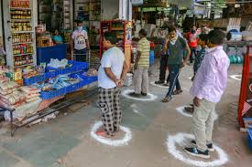
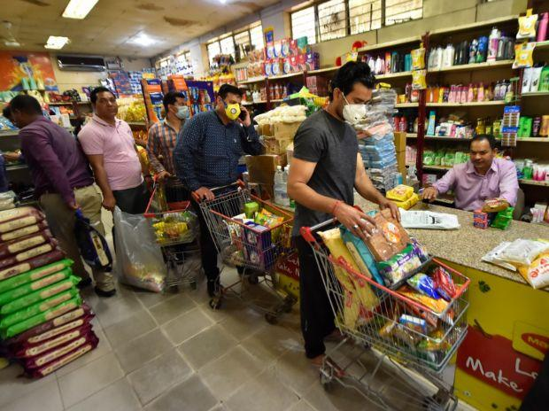
We Observed that . . .
Developed cities have Groceries in every nook and corner with sufficient stock.

Slide 3
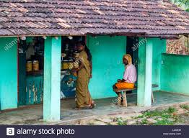
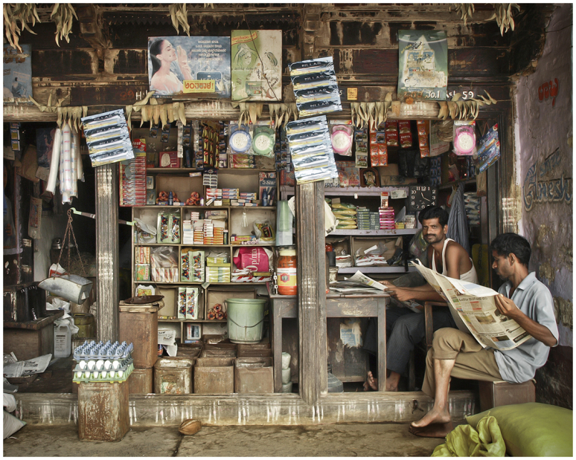
What about the Rural Areas/Small Cities??
Shops at distant
very limited stock

Slide 4
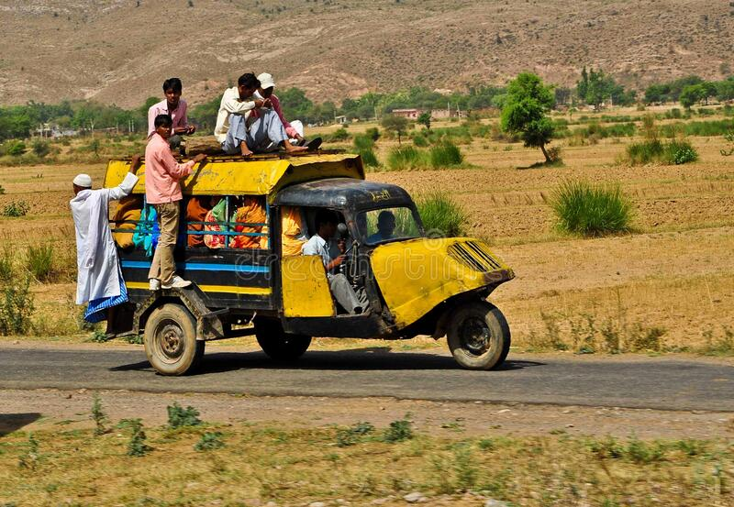
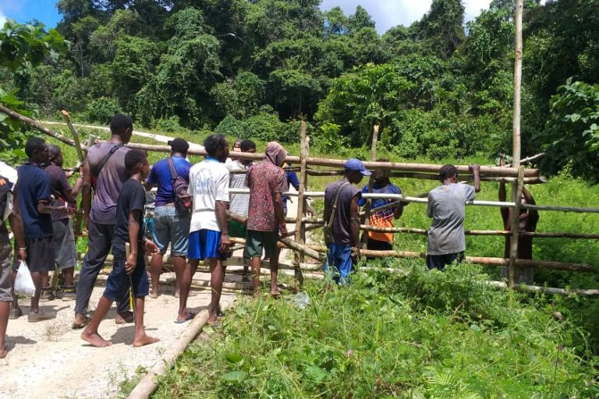
Highly Prone to Virus travel distance restrictions

Slide 5
SOLUTIONS:-
online availability of FMCG for Remote areas.
User-Friendly website.
USSD booking Service.

Slide 6

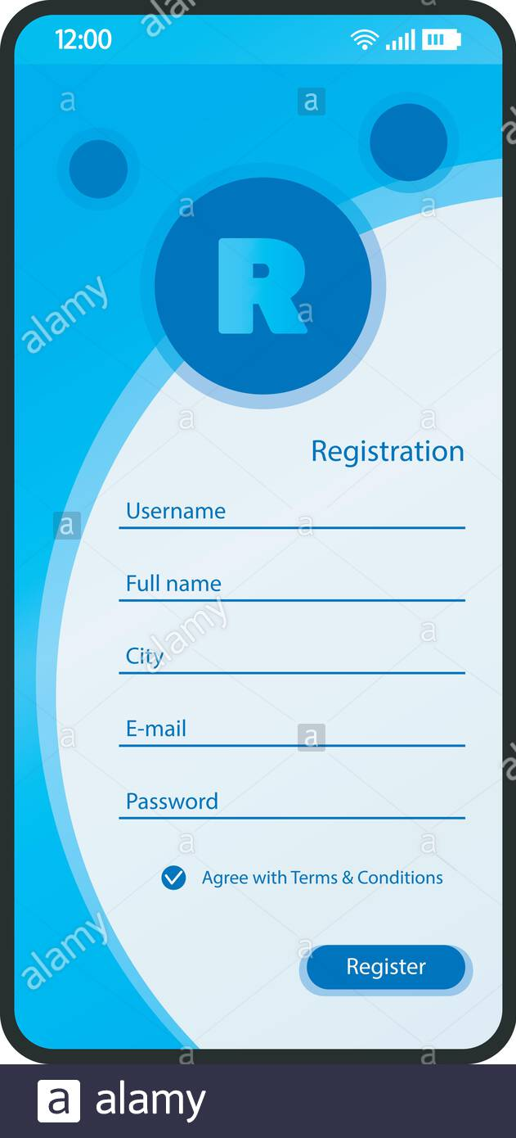
House Numbers

